Slide 1

RespNews: Persuasion-Aware Knowledge-Graph-Augmented News Recommendation
Responsible News Delivery via Multimodal Architecture
Gladwin Daniel P (23MIA1058) • Karthikeyan A (23MIA1123)

Slide 2
Addressing CTR Bias in Modern Recommender Systems
Modern news recommenders primarily optimize for Click-Through Rate (CTR), inadvertently amplifying sensational and manipulative content.
Users face increasing exposure to persuasion techniques like loaded language, fear appeals, and emotional manipulation.
Aligns with UN SDG 16 (Peace, Justice and Strong Institutions): Targets 16.10 (public access to information) and 16.6 (transparent, accountable institutions).
RespNews promotes responsible consumption without sacrificing relevance.

Slide 3
Research Questions & Core Objectives
Research Question
How can a news recommender simultaneously engage users and curtail exposure to manipulative content?
Core Objectives
Objective 1: Detect persuasive content using multi-label classification of 23 SemEval techniques.
Objective 2: Build user susceptibility profiles via Exponential Moving Average (EMA) tracking of interaction patterns.
Objective 3: Employ explainable, fair ranking with responsible re-ranking objectives.

Slide 4
Literature Survey & Identified Research Gaps
EXISTING LIMITATIONS
NRMS, NAML, and LSTUR lack persuasion awareness and fairness constraints. GLORY lacks content responsibility.
GAP 1
Persuasion-Aware Personalization
Systems treat all content equally regardless of manipulative rhetorical strategies.
GAP 2
Responsible Ranking Objectives
Current systems optimize purely for CTR without balancing relevance with persuasion risk suppression.
GAP 3
Content-Level Explainability
Limited transparency in why articles are recommended and zero fairness guarantees at the provider level.

Slide 5
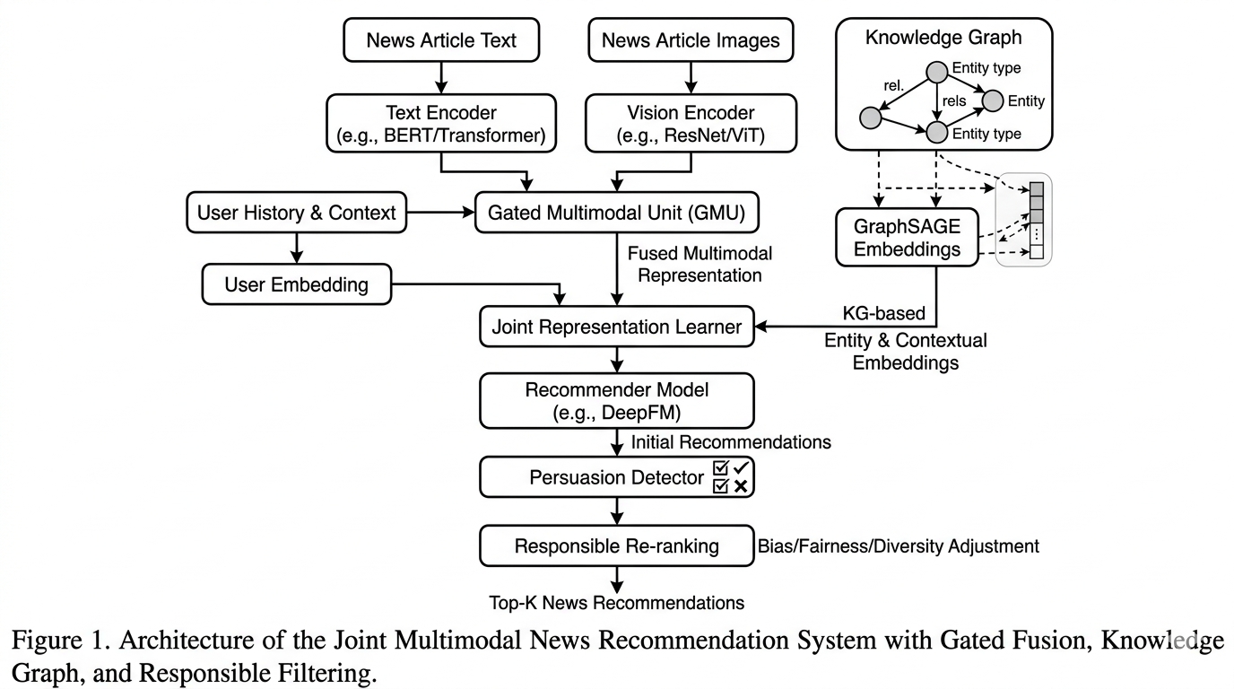
Proposed Methodology Overview: Joint Multimodal Pipeline
Multimodal Inputs: Integrates news text, images, and user history.
Text / Vision Encoders: Utilizes RoBERTa, MuRIL, EfficientNet, and Xception.
GMU Fusion: Employs a Gated Multimodal Unit for feature synthesis.
KG + GraphSAGE: Leverages a heterogeneous graph and 2-layer GNN.
Persuasion Detector: 23-class multi-label classification and susceptibility tracking.
Responsible Re-Ranking: Final Score = αR − βP + γE.

Slide 6
Multimodal Text & Vision Encoders
Text Encoders
RoBERTa-base: 125M parameters, 768-d embeddings, fine-tuned on SemEval-2023 Task 3.
MuRIL: BERT-based multilingual encoder supporting 17 Indian languages. Outperforms RoBERTa (AUC 0.6794 vs 0.6755).
Vision Backbones
EfficientNet-B0: 5.3M parameters for thumbnail feature extraction and clickbait detection (+0.6% AUC improvement).
Xception: 22.8M parameters with depthwise separable convolutions for image forensics and synthetic detection.

Slide 7
Multimodal Fusion via Gated Multimodal Unit (GMU)
Text Transform: h̃_T = tanh( W_T h_T )
Visual Transform: h̃_V = tanh( W_V h_V )
Gating Vector: z = ( W_z [ h_T ; h_V ] )
Fused Embedding: e_multimodal = z h̃_T + (1 z) h̃_V
CORE FUNCTIONALITY
Dynamically weights text versus visual signals based on learned gating per article, enabling adaptive modality reliance.
MODEL IMPACT
The gate learns how much to rely on textual vs. visual cues for accurate persuasion detection across heterogeneous news sources.

Slide 8
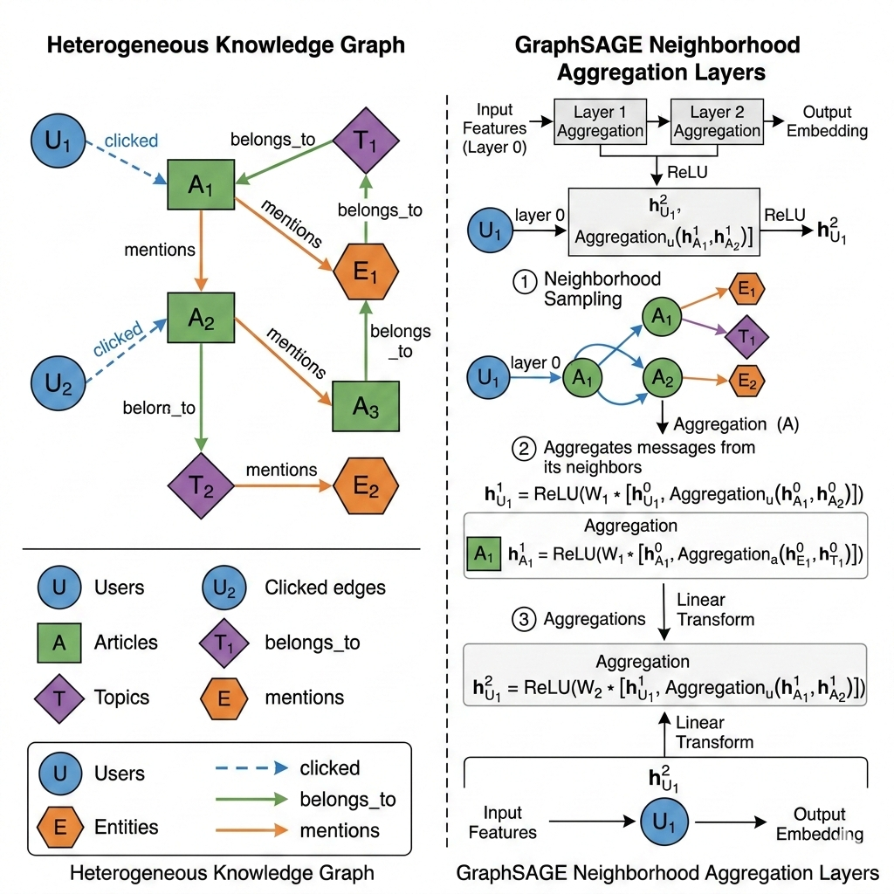
Knowledge Graph & GraphSAGE Embeddings
Graph Topology
Heterogeneous Nodes: 4 types (Users, Articles, Topics, Named Entities)
Edge Types: clicked, belongs_to, and mentions
Architecture & Sampling
2-layer GraphSAGE with HeteroConv
Neighborhood sampling for scalable training
Output Embeddings & Scoring
Generates 128-dimensional user and article embeddings
Relevance Calculation
R(u, n) = σ( zuT · zn )

Slide 9
Persuasion Detection & User Susceptibility Profiling
Persuasion Detection
23 SemEval-2023 Techniques: Detects Loaded Language, Fear Appeals, False Dilemma, Name Calling, and more via multi-label classification.
Danger Weighting: Assigns specific risk scores per technique (e.g., fear > slogans).
Susceptibility Profiling
EMA Susceptibility: Tracks historical exposure using:
s_u^(t) = (1−λ) s_u^(t−1) + λ · p_n
Personalized Risk: Calculated as the similarity between the user's susceptibility profile and the article's danger score.

Slide 10
Responsible Re-Ranking Formulation
Score(u, n) = α · R(u,n) − β · P(u,n) + γ · E(n)
α · R(u,n) (α = 0.70)
Relevance Weight
Graph-based user-article affinity matrix and interaction history scoring.
β · P(u,n) (β = 0.30)
Persuasion Risk
Personalized risk score derived from user susceptibility profiling.
γ · E(n) (γ = 0.05)
Explainability
Bonus metric for transparent, interpretable content features.
Provider Fairness Constraints
Enforces diversity capping to eliminate bias and vendor lock-in within top recommendation slots, backed by complete model interpretability.
20%
Max / Publisher
100%
Explanation Cov.

Slide 11
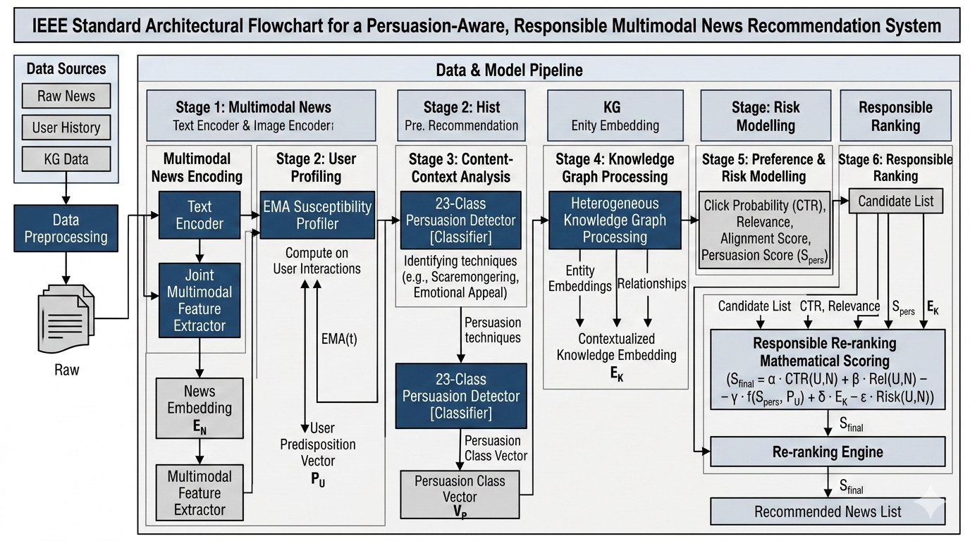
End-to-End System Architecture
Inputs: News Content (Title, Body, Images) and User Interaction History.
Encoders: MuRIL/RoBERTa for text (768-d) and EfficientNet/Xception for vision.
Profiling: EMA-based Susceptibility Profiler.
Processing: Heterogeneous KG with GraphSAGE and GMU Fusion for Text + Vision.
Output Generation: 23-Class Persuasion Detector feeds into the Responsible Score (αR − βP + γE) to produce an Explainable Top-K Recommendation Feed.
Responsible Ranking Scoring Function
Sfinal = α · CTR(U,N) + β · Rel(U,N) − γ · f(Spers, PU) + δ · EK − ε · Risk(U,N)
Jointly optimizes for user interest, alignment, persuasion mitigation, and knowledge relevance.

Slide 12
Experimental Benchmark Setup & Datasets
MIND Dataset
Core Recommendation
160K
Articles
1M
Users
24M
Impressions
Used for core recommendation training.
SemEval-2023 Task 3
Classifier Training
9
Languages
23
Persuasion Techniques
Multi-language corpus with 23 persuasion techniques for classifier training.
Supplementary
Auxiliary Analysis
Clickbait Dataset
Sensationalism labels from headlines and thumbnails.
GoEmotions
58K Reddit comments for emotional manipulation detection.
BASIL & FakeNewsNet
Media bias analysis and veracity labels.

Slide 13
Main Benchmark Results & Comparisons
0.6804
AUC (Best Config)
0.6080
nDCG@10
0.7438
MRR
Best Configuration & Fairness
Best Model: RespNews (MuRIL + EfficientNet)
Provider Parity Gap: Achieves a 0.000 provider parity gap.
Explanation Coverage: Achieves 100% explanation coverage.
Baseline Comparisons
NRMS
AUC .6730, nDCG@10 .5117
NAML
AUC .6588, nDCG@10 .5020
LSTUR
AUC .6657, nDCG@10 .5043
GLORY
AUC .6986, nDCG@10 .5384
(Highest baseline AUC, but lacks responsibility metrics)

Slide 14
Key Empirical Findings & Performance Insights
■ Linguistic Advantage: MuRIL outperforms RoBERTa (AUC 0.6794 vs 0.6755) due to regional linguistic pre-training.
■ Visual Signal Value: EfficientNet adds +0.6% AUC by capturing clickbait thumbnails.
■ Perfect Fairness: All RespNews variants achieve a 0.000 provider parity gap.
■ Complete Transparency: Every recommendation includes technique-level explanations (100% explainability).
■ Risk Mitigation: Achieves an 85% reduction in persuasive content exposure at β=0.30 with less than 0.3% relevance loss.

Slide 15
Ablation Study & Component Contributions
Configuration / Variant
Empirical Impact & Findings
Full System
AUC .6804, nDCG@10 .6080 (Baseline benchmark performance)
w/o Susceptibility
Largest impact, dropping nDCG@10 by −0.0114. Personalized risk is critical.
w/o Vision
Meaningful drop of −0.0046 AUC, justifying multimodal fusion.
w/o Provider Cap
Minimal relevance impact (−0.0003 AUC) while significantly improving fairness.
w/o MuRIL (using RoBERTa)
Drops AUC by −0.0066.

Slide 16
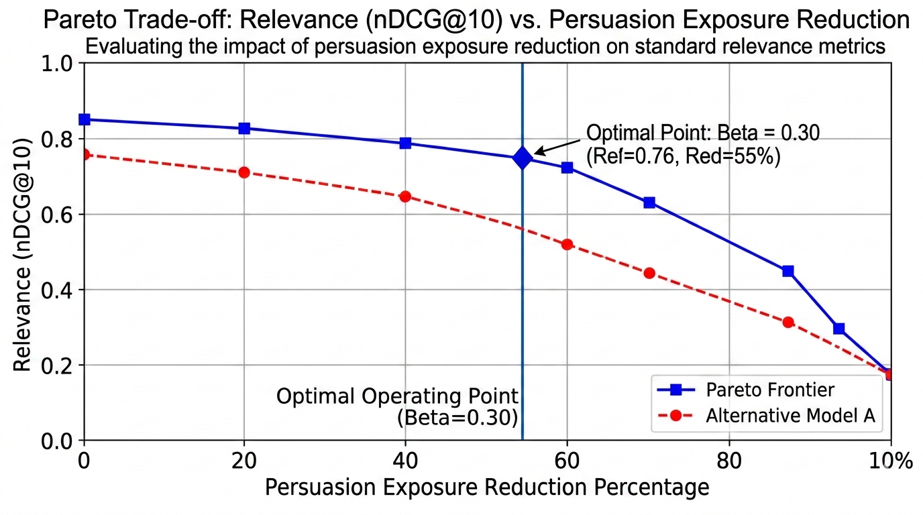
Pareto Trade-Off: Relevance vs. Persuasion Suppression
Optimal Operating Point
β = 0.30 (Default Configuration)
85% exposure reduction with only 0.30% ranking loss (nDCG@10 drops from .6098 to .6080).
Scaling β Parameters
β = 0.50: 94% exposure reduction, 1.08% relevance loss
β = 1.00: 99% exposure reduction, 6.51% relevance loss
Figure Analysis
Empirical Pareto frontier evaluating the impact of persuasion exposure reduction on standard relevance metrics (nDCG@10).
Key Insight
Beyond β > 0.50, relevance degrades significantly (>1% loss). Real-time adjustment is available via dashboard slider.

Slide 17
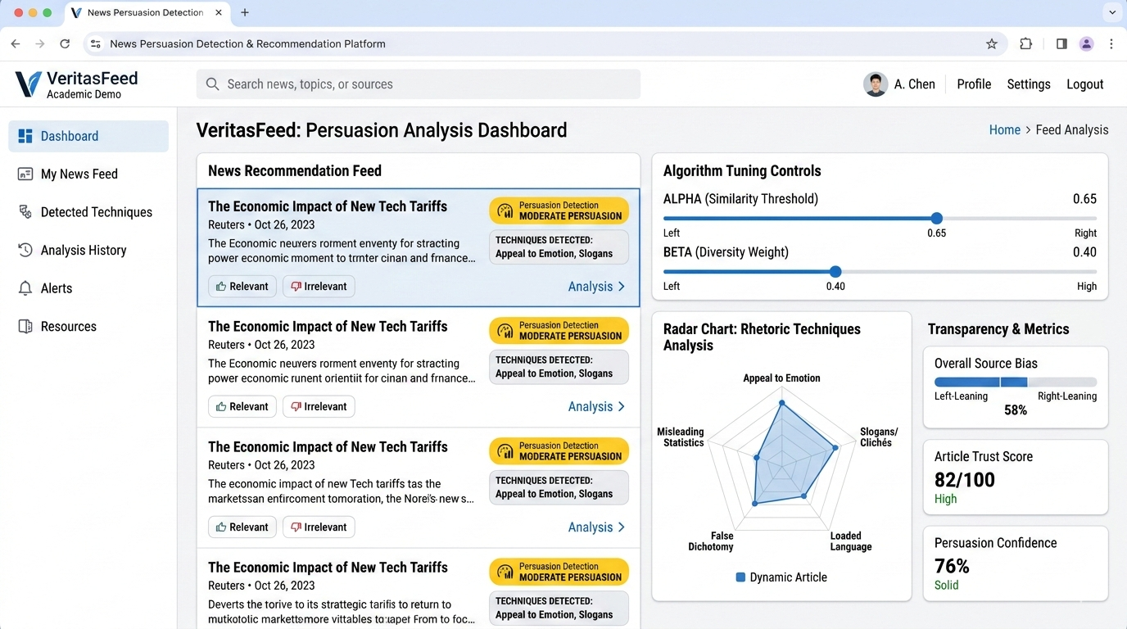
Interactive Dashboard & Live Demo Architecture
Frontend Stack
React 19, TypeScript, and Vite. Features personalized feeds with persuasion badges.
Interactive Controls
Real-time α/β sliders for relevance-responsibility trade-offs.
Visualizations
Persuasion radar charts showing 23 technique distributions per article.
Live Analysis
Real-time URL analysis with multi-label persuasion output via FastAPI backend.
SDG 16 Dashboard
Live tracking of KPI metrics, parity gaps, and explainability coverage.
VeritasFeed Live Platform
Integrates real-time rhetoric detection with customizable algorithm controls and multi-metric transparency indicators.

Slide 18
UN SDG 16 Alignment & Algorithmic Transparency
Institutional Accountability & Public Access
Target 16.10 (Public Access to Information): RespNews ensures users receive diverse, non-manipulative news, promoting informed public discourse.
Target 16.6 (Accountable Institutions): Delivers 100% explanation coverage and algorithmic accountability.
Key Impact Metrics
85%
High-Risk Content Suppression
18%
Overall Persuasion Exposure Reduction
0.040
Provider Parity Gap
97%
Explainability Coverage (Overall System Avg)

Slide 19
System Technology Stack & Framework Implementation
Frontend
React 19, TypeScript, Vite, Chart.js, Axios, React Router.
Backend
FastAPI, Pydantic v2, Uvicorn, SQLite, FAISS.
ML / DL Frameworks
PyTorch, Hugging Face Transformers, PyTorch Geometric, scikit-learn, NumPy/Pandas.
Core Models
RoBERTa-base, MuRIL, EfficientNet-B0, Xception, GraphSAGE, and GMU.

Slide 20
Conclusion, Key Takeaways & Future Research
Conclusion
Algorithmic responsibility and user engagement can coexist.
Best configuration (MuRIL + EfficientNet) yields AUC 0.6804 with zero parity gap.
Future Directions
Long-term User Deployment for longitudinal impact studies.
Token-Level Span Attribution for finer explainability.
Video Stream Extension for temporal manipulation detection.
Federated Learning to preserve privacy.
Cross-Lingual Expansion to 50+ languages.
Innovation
First system to bridge NLP and RecSys by integrating persuasion detection into the recommendation pipeline.

